Slide 1
Agile is an Experiment - How and why?
    Padma Priya Devarajan

Slide 2
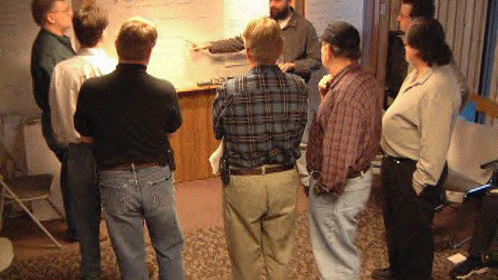
Agile is an experiment, Why?

Slide 3
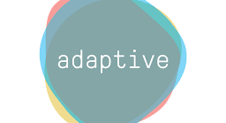

Slide 4
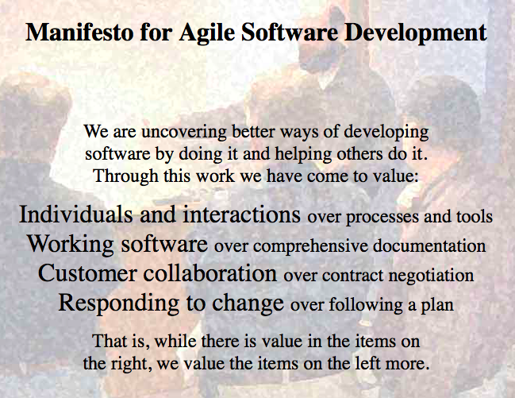

Slide 5

Agile is a Teen
Disclaimer : Illustrative purpose only, Agile may not be as beautiful as Bengal lady!!.

Slide 6

Updated Agile Manifesto
    Manifesto for Agile Solutions Development
    We are uncovering better ways of developing Products
    by doing it and helping others do it.
    Through this work we have come to value:
    Common Goal/Ambitious Vision over Individuals and interactions.
    Value flow over working software.
    Expanded Relationship with all stakeholders over Customer collaboration
    Proactive ideas and Continuous improvement over Responding to change
    That is, while there is value in the items on
    the right, we value the items on the left more.

Slide 7
Agile experiment success factors
Leadership Support
Stakeholder Engagement
Wonderful Teams

Slide 8
Agile Experiment may fail…
Unable to understand Agile .
Company philosophy or culture thats odds with Agile values.
Overlap of operational issues.

Slide 9

Is it really everywhere?

Slide 10
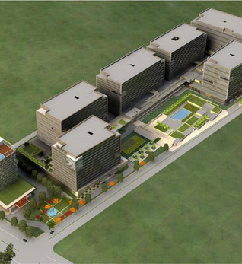

Agile is an experiment.. How??
A case study on no-no domain of agile - Infrastructure
Type to enter a caption.
Type to enter a caption.

Slide 11
Key learnings
Agile is not solution for failing projects, though it may be..
Inspite of your decades of your experience, each Agile transformation is a new experiment with success depending on 3 amigos, Agile, Org and client.
Agile trail is not yet completed and established.
A strong imbibed Common Goal is key for success.

Slide 12
References
1www.Agilemanifesto.org
2. Schlabach, K. E. (2008, December 4). Snake on the wall. Retrieved from http://agile-commentary.blogspot.de/2008/12/snake-on-wall.html .
3. Scrum Alliance. (2012, August 31). Class and certification statistics. Retrieved from http://www.scrumalliance.org/resources/2505 .
4. The Agile Alliance. (2001, February). Manifesto for agile software development. Retrieved from http://agilemanifesto.org/ .
5. Turner, R., & Zolin, R. (2012). Forecasting success on large projects: Developing reliable scale to predict multiple perspectives by multiple stakeholders over multiple time frames. Project Management Journal, 43(5), 87-99.
6. VersionOne. (2013). 7th annual state of agile development survey. VersionOne.

Slide 13
Thank you!
Keep experimenting with Agile!!

