Slide 1

Failure To Success

Slide 2
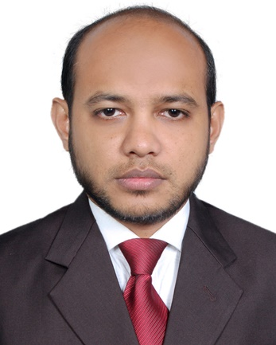
























I am your Co-Learner
Ahmed Zafor Sadeq Bhuiyan
Consultant, World Bank Group
Faculty:
Facilitator:

Slide 3
A Data Center Project

Slide 4
Project Background

Slide 5
Advanced DC
Supreme Technology
Highly Secured
Virtualized
Limited Expertise
Full Turnkey

Slide 6
Facing Failure

Slide 7
Merger
Resource Movement
Change in Focus
Lack of Expertise
Notes:
Organization merged with a global giant
Experience resource moved to an International project.
Mid management focus moved to international project.
No expertise available in local market.

Slide 8
Progress Declined by Customer
Team Motivation went down
Delivery Time Over
New requirements
Notes:
Project progress rejected by customer
New requirements from customer
Delivery time over
Motivation of remaining team members goes down

Slide 9
Looking for Workaround

Slide 10
Way forward
Proposed Agile/Scrum
Stakeholders rejected
Two planning session
Delivery team afraid
Customer want completion
Notes:
Internal stakeholders are looking for way forward and alternate options.
PM proposed to follow Agile/Scrum as workaround.
Stakeholders have no ideas about Agile/Scrum so they rejected.
Delivery team also have no idea about Agile/Scrum, so they are afraid of it.
Customer refused any new delivery method but want completion of the project
PM arranged two way forward planning session, one with internal stakeholders and one with customer about Agile/Scrum but not mentioning it as Agile/Scrum.. After that session both stake holders are agreed to follow but without new terminologies

Slide 11
Moving to Success

Slide 12
New Deadline
List of Pending Tasks
3 Milestone
Lesson learn review
Daily status meeting
Milestone progress review
Notes:
Customer give 4 months to complete remaining tasks
Pending all task in one list with completion priority form customer (PB)
Delivery team decided to put all to do tasks in 3 milestone (one month each)- (Sprint)
Daily 15 min status meeting within delivery team (DS)
Monthly progress review (SR)
Lesson learn review (retro)
Remaining backlog refined based on lesson learned & customer feedback

Slide 13
Achieving Success

Slide 14
1st Sprint
Motivated Team
Refined Backlog
Happy Customer
2nd & 3rd Sprint
Remaining Tasks
Notes:
1st sprint completed with 80% task completion
Team motivation increased.
Backlog refinement done based on lesson learned
2nd & 3rd sprint completed with 90% & 95% task completion rate.
Remaining task completed in 4th sprint.
Total project handover completed in 4th sprint
Happy customer & Happy management

Slide 15


Slide 16




For Further Contact
www.linkedin.com/in/ahmedzaforsadeq
zafor79@gmail.com
+8801711084659

