Slide 1

h

Slide 2
Technical Debt – A Slow Death!!

Slide 3
Agenda
Activity
How does it Accumulate
Impact of Technical Debt
Case Study
Q&A

Slide 4
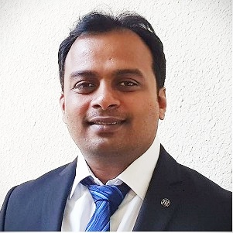
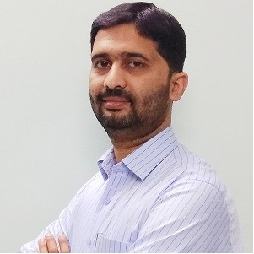
Narasimha Badrinath
Agile & DevOps Coach
IBM
https://www.linkedin.com/in/narasimhab
Yasub Hashmi
Agile Technical Coach
Accenture
https://www.linkedin.com/in/yasub

Slide 5
What incurs Tech Debt?
Architecture
Complexity
Structure
Test Coverage
Duplication
A Negative Impact on PRODUCTIVITY
Code Smells
Potential Bugs
Coding Practices and Style
Comments & Documentation

Slide 6
Common Causes
Business Pressure
Delayed Refactoring
Poor Technical Leadership
Lack of Ownership
Lack of Collaboration
Parallel Development

Slide 7
Technical Debt Over Time

Slide 8


Who NEEDs to Pay attention?
PO
Dev Team
SM (Agile Coach)

Slide 9
Can you avoid Tech Debt?
NO
YES

Slide 10

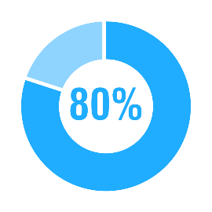












Technical Debt – Case Study
Refactor Slow & Steady
TDD
SOLID Principles
Refactored One Module
Coding Standards
Project Approval
and Kickoff
5%
Revise DoD
Unmaintainable code
Aug 2009
Jul 2010
Jan 2011
Mar 2011
May 2011
Dec 2011
Rework
Late nights
Decision to refactor
Less features
Frustration

Slide 11
What’s Next?
Measure
Raise Transparency
Plan
Negotiate
Implement

Slide 12
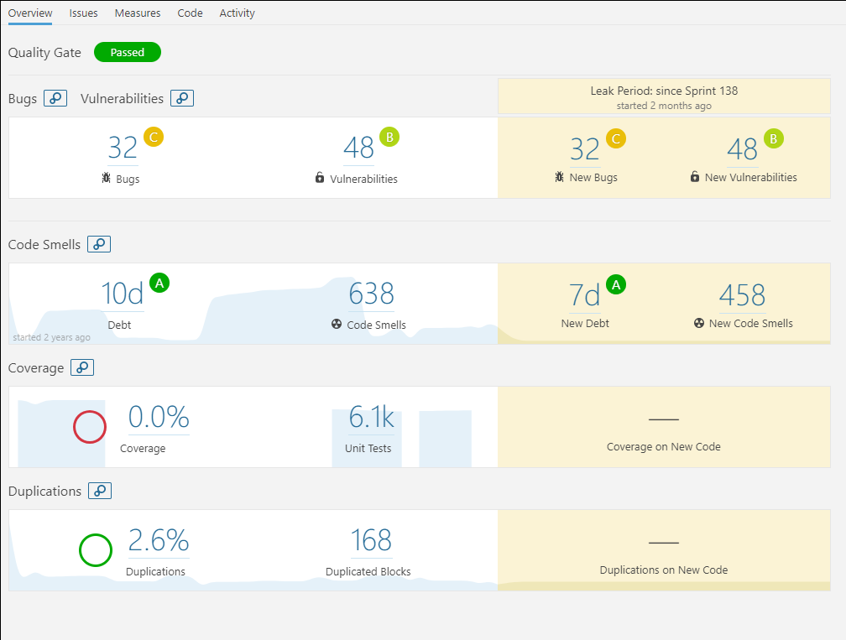
One of the ways to measure (SonarQube)

Slide 13
References & Additional resources
https://en.wikipedia.org/wiki/Technical_debt
https://www.agilealliance.org/introduction-to-the-technical-debt-concept/
https://refactoring.guru/refactoring/
The Three Laws of TDD
Clean Code By Robert C. Martin
Flipping The Bit

Slide 14
&
A
Q

